Slide 1
Economic & Regulatory Capital, Provisions and Stress Testing IFRS 9 and Expected Credit Loss

Slide 2
Lecture Four – A Summary
IAS 39 and it’s weaknesses
IFRS 9 and it’s positives and negatives
IFRS 9 and Covid-19
What impact has Covid-19 had on IFRS 9 (and bank provisions)
How long will IFRS 9 last?

Slide 3
Old Rules: Provisioning under IAS39
Banks must calculate provisions in their financial statements in accordance with Accounting Standards
IAS39 required banks to provide for losses which have been incurred only. A bank must have objective evidence of possible loss & impairment before raising a provision
No provisions were permitted for future expected losses no matter how likely. Put simply, a provision could not be raised against a performing customer, even if the bank knew that customer was about to default
A new accounting standard was introduced on 1/1/2018. IFRS9 focuses on expected loss rather than the IAS39 incurred loss approach.

Slide 4
Impaired Assets under IAS39
A financial asset or a group of financial assets is impaired and impairment losses are incurred if, and only if:
there is objective evidence of impairment as a result of one or more events that occurred after the initial recognition of the asset (a 'loss event') and
that loss event (or events) has an impact on the estimated future cash flows of the financial asset or group of financial assets that can be reliably estimated.” (IAS 39.59)

Slide 5
What Constituted Objective Evidence?
Actual breach of contract (default, delinquency in payments, covenant breach)
Borrower granted concessions due to financial difficulties (forbearance)
Debtor has significant financial difficulty
Debtor receives major downgrade by an external agency
High probability of bankruptcy or financial reorganisation
Disappearance of an “active market” in the asset
Adverse changes in the payment status of borrowers in the group (e.g. changes in internal scores)
Economic conditions that correlate with defaults on the assets in the group

Slide 6
What Happened Next?
For impaired assets, a provision for credit loss was calculated as follows:
Estimate all future cash flows associated with that asset
Estimate the net present value of these accumulated cash flows, discounted at the effective interest rate of the loan
Compare this net present value to the balance of the outstanding asset
Raise a provision for any shortfall

Slide 7
Types of Provisions
Individually assessed provision for large or complex assets. Consider as an example a loan to fund a shopping centre with multiple tenants.
Collective provision for calculated using a statistical model for smaller standard (typically retail) assets. A good example is a mortgage portfolio.
Finally, there existed the concept of a latent provision (IBNR). This latent provision for the currently performing portfolio attempted to reflect the existence of a (small number of) assets that are not performing but appear to be. An impairment event has occurred but has not yet affected obligor performance to the extent that the bank can identify objective evidence of impairment.
In simple terms an impairment event has occurred that is not yet visible to the bank. Consider a mortgage holder who has lost her job as an example. The trigger for default has occurred but default itself may be delayed by months, pending use of savings to stay afloat.

Slide 8
Individually Assessed Provision
A typical process was as follows:
The relationship manager or problem debt manager determined cash flow inputs based on knowledge of customer, security which could be realised, external market conditions and other relevant information
The bank provided detailed guidelines to support this process. This included valuation approach to use for security, time to repossess and dispose of security, cash flow estimates of customer repayments, level and type of costs to include in provision calculation, etc.
The provision went through a review / approval process and was updated on a regular basis thereafter
Provision assumptions were aligned with the strategy identified by the bank to deal with the customer. Thus, for example, the bank may have had a different strategy for non-engaging customers than engaging customers and the provisions estimate reflected this
The provision calculation took account of time value of money, using the interest rate of the exposure to discount future cash flows. This was a key difference between provisions and capital loss calculations.

Slide 9
Individual Assessment Challenges
It was not as easy as it sounds! Challenges include:
How do we estimate the quantum and timing of cash receipts?
How and when do we value collateral?
What recovery actions will be taken and at what cost?
How will the obligor behave through the process?
What are the likely future market and economic conditions?
Are other cases treated similarly? Is there consistency across the portfolio?
How frequently should we update the estimate?

Slide 10
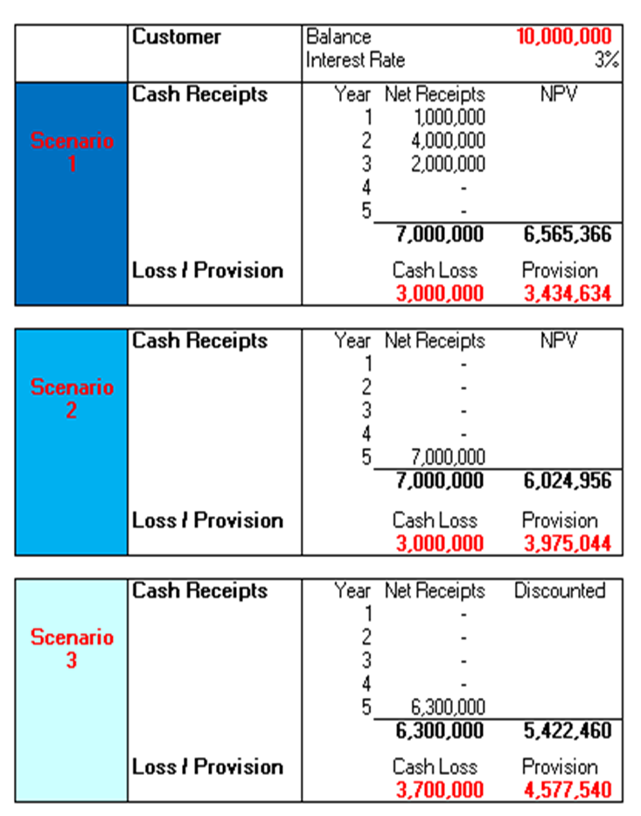
Individual Assessment Simple Example
Changes in cash flow timing or costs can have a dramatic impact on the provision
Scenario 1
Cash Loss €3m
Provision €3.4m
Scenario 2
No change in Cash Loss €3m
Provision increased to €3.975m due to delay in receipt of cash
Scenario 3
Cash Loss increased due to addition of 10% selling costs €3.7m
Provision increased to €4.57m

Slide 11
Collective Provision – Original Approach
Pooled impairment & provision assessment - “High Volume / Low Value” cases – not practical to undertake individual provisions for these case (typically debtors up to a threshold of c.€500k - but varies bank to bank)
Typically used in retail portfolios ( mortgages / personal loans / credit cards) and smaller commercial portfolios ( sole traders / small businesses)
Pools - Portfolios of assets with similar risk characteristics – pools might be based on product ( e.g. mortgages / personal loans) or business unit (eg. RI Commercial / NI Commercial) or vintage/customers status / forbearance arrangement
Cure rate (how many customers fully recover and no loss will be ultimately be suffered) - % of loans expected to recover to a performing status. Typically based on historical experience.
Loss rate (what is the average loss for each pool) - typically takes account of security value, disposal costs, discounting (time / interest rate)
Provision = Defaulted Pool Balance * (1 – Cure Rate) * Loss Rate

Slide 12
Collective Provision – Improvements
As with many other areas, IAS39 provisions modelling increased dramatically in complexity post 2000 given
Larger data sets contained within bespoke data marts
Cheaply available statistical software to cleanse and model data
Advances in modelling techniques
By 2010 models typically estimated provisions at account level rather than at portfolio level. Individual exposures had a specific cure estimate rather than using a portfolio average. This individual estimate was based on advanced statistical analysis of historical data that identified drivers of cure, akin to capital models. Like capital models, account level losses could be estimated. The portfolio provision was then the sum of individual exposure provisions.

Slide 13
Latent Provision for Performing Portfolio
Latent loss provisions were provisions held against the estimated impaired loans in the performing portfolio which had yet to be identified. The idea was that there were certain loans that were impaired but still invisible. Another name for latent provisions was IBNR – incurred but not reported.
A key part of latent provisioning was to estimate the length of the time period that an asset could remain impaired within a performing portfolio before would be identified and reported as such. This was the emergence period (EP) and could exceed a year in certain cases!
We calculated our best estimate of the average PD and LGD for the portfolio: Then the latent provision was:
Balance * PD * LGD * EP
Latent provisions were general provisions against the portfolio.

Slide 14
The CBI Perspective
The CBI issued a 2013 document:
Impairment Provisioning and Disclosure Guidelines for Covered Institutions
Covered Institutions should:
Recognise their incurred loan losses as early as possible within the context of International Financial Reporting Standards (“IFRS”)
Adopt a sufficiently conservative and comparable approach to the measurement of impairment provisions across all loan portfolios
Significantly improve the number and granularity of their asset quality and credit risk management disclosures which will enhance users understanding of their asset quality profiles and credit risk management practices.
Tension between regulators and accounting bodies??

Slide 15
Criticisms of IAS39
The general feeling about IAS 39 was one of “too little, too late” when it came to impairment losses. Even when banks saw losses coming, they weren’t able to record them until they were incurred. The financial crisis, some say, could have been averted or at least flagged earlier if this hadn’t been the case.
The lead audit partner at PwC on Bank of Ireland between 2010 and 2014, told the Banking Inquiry that audit rules were found wanting when applied to the financial statements of Irish banks during the financial crisis.
“IFRS (international financial reporting standards) set the rules which had to be applied in the financial statements of Irish banks during the financial crisis,” he said. “The financial crisis tested some of these rules and found them wanting. Changes have now been made. “But, nonetheless, they were the prevailing rules and notwithstanding one’s view of their fitness for purpose, they were required to be applied. The accounting rules of the time did not allow the recognition of future events or risks.”

Slide 16
A Peculiarly Irish Challenge Back Then
Retail mortgages comprise the largest portfolio in most Irish banks and pose many challenges to provisions modelling. These include:
Cure rate modelling: How do we identify those people who can pay but won’t. Clearly the cure dynamics are very different for that cohort (however small) than standard defaulters who are trying to pay
Forbearance modelling: Clearly, banks offer forbearance to assist customers. Many forbearance solutions are long term offers. While the institution may predict short term behavior what of long term? These estimates were necessary in order to estimate cash flows.
Collateral modelling: Repossession is a necessary feature of mortgage modelling. However, for many distressed borrowers that potential event is some years away, given current processes. What value should banks apply to future property repossessions and when are such events likely to occur? Will the borrower allow the property to fall into ruin – repossession loss?
The famous Dunne judgment – see CBI research.

Slide 17
The Dunne Judgment: 25th July 2011
The layman RTE report that day:
The High Court ruled today that a lending institution cannot apply for an order for possession where a mortgage was created before December 1st 2009 but a demand for full payment was not made until after that. Ms Justice Elizabeth Dunne was giving her decision in four cases taken by lawyers linked to the New Beginning group.
The decision arises due to the repeal of 1964 legislation by the Land and Conveyancing Reform Act of 2009. The 2009 Act came into force on December 1st 2009 and covers only mortgages taken out since then.
Ms Justice Dunne ruled that a lender can apply for an order under the old legislation only if it makes a demand for the principal monies due before December 2009. She struck out a case in which that had not happened.
She said the repeal of the old legislation had created a 'lacuna' and it was not for the court to supply that which was not in the 2009 Act.

Slide 18
Provisioning under IFRS 9
IFRS-9 is a comprehensive standard for loan accounting that went live on 1st January 2018 with a range of topics including:
Recognition
Classification
Disclosure
The most challenging and complex element of the new standard was the requirement to measure impairment and record a corresponding allowance using three distinct categories rather than the IAS39 two categories.
As concerns were raised about ‘too little, too late’ provisioning for loan losses the lifetime expected credit loss framework has aimed to address this weakness.

Slide 19
IFRS 9 calculates Expected Credit Loss (ECL)
The three categories are as follows:
Stage 1 loans have 12 month Expected Credit Loss (ECL)
12-Month Expected Losses: To be applied to performing loans where the credit risk has not increased significantly since loan origination. These stay in Stage 1 and the provision is
Balance * 12 month PD * LGD
The concept of an emergence period has been removed
The conceptual breakthrough is the acknowledgement that every single loan has a specific provision attached to it.

Slide 20
IFRS 9 calculates Expected Credit Loss (ECL)
Stage 2 loans have a lifetime ECL
Lifetime Expected Losses: These are calculated where credit risk has increased significantly since loan origination, although the loan has not necessarily shown any sign of impairment. These are in Stage 2 with provision
Balance * Lifetime PD * LGD
Stage 3 loans are effectively the same as the IAS39 impaired definition
Stage 3 is non-performing loans with provision calculated as
Balance * LGD (same as before as PD = 1)

Slide 21
IFRS 9: Simple Picture

Slide 22
Comparing IFRS 9 to IAS 39
The scope of the impairment requirements is now much broader. Previously, under IAS 39, loss allowances were only recorded for impaired loans
The new requirements result in earlier recognition of credit losses, by necessitating a 12-month ECL allowance for all credit loans.
The recognition of lifetime ECLs is expected to be earlier and larger for all credit loans that have significantly deteriorated as a lifetime PD is likely to be very many multiples of a one-year PD
While credit loans in ‘Stage 3’, as illustrated in the above diagram, are similar to those deemed by IAS 39 to have suffered individual incurred losses, credit loan in ‘Stages 1 and 2’ will essentially replace those loans measured under IAS 39’s latent approach, but with vastly higher provisions

Slide 23
IFRS 9 Multiple Economic Scenarios
ECL is an unbiased and probability-weighted amount that is determined by
Evaluating a range of possible outcomes
Incorporating the time value of money
Based on reasonable and supportable information
How many outcomes should we consider?
Should we consider a discrete number of scenarios and give them probabilities to reflect likelihood?
What about Monte Carlo simulation of the future?

Slide 24
IFRS 9 SICR
Movement from Stage 1 to Stage 2, with consequent increase in ECL, is predicated on significant increase in credit risk (SICR). At each reporting date, an entity shall assess whether the credit risk on a financial instrument has increased significantly since initial recognition.
Obvious questions follow:
Should PD be the methodology to apply SICR rules?
How large does an increase in PD need to be?
Should PD increases be absolute or relative?
Should increases be relative to original one-year PD or original lifetime PD?

Slide 25
IFRS 9 Reasonable / Supportable Information
The ECL model is more forward looking than the IAS 39 impairment model. This is because holders of financial assets are not only required to consider historical information that is adjusted to reflect the effects of current conditions and information that provides objective evidence that financial assets are impaired in relation to incurred losses, but they are now required to consider reasonable and supportable information that includes forecasts of future economic conditions when calculating ECL
What is reasonable and supportable information?
How did IFRS 9 do with Brexit?
How will IFRS 9 do with Covid-19?

Slide 26
IFRS 9 Pro-Cyclicality Impact
The focus on expected losses has resulted in higher volatility in the ECL amounts charged to profit or loss for banks. Losses will clearly increase as economic conditions are forecast to deteriorate and will decrease as economic conditions are more favourable, compounded by the significant increase in loss allowance when loans move between 12-month and lifetime ECLs and vice versa
The need to incorporate forward-looking information means that application of the standard will require considerable judgement as to how changes in macroeconomic factors will affect ECLs. Also, the increased level of judgement required in making the ECL calculation may mean that it will be difficult to compare the reported results of different entities
Against that, the more detailed disclosures required by IFRS 9 (compared with those required to complement IAS 39) that require entities to explain their inputs, assumptions and techniques used in estimating ECL requirements, should provide greater transparency over entities’ credit risk and provisioning processes

Slide 27
IFRS 9: The Big Practical Challenges
Non-Linearity of Losses
Performance of models has been weak in this context
PD and LGD interactions are difficult to model
Ultimately, losses on downside scenarios should be many multiples of benefits on upside scenarios – this has proven difficult to achieve
Origination PD
Consider the typical mortgage portfolio with a range of aged exposures
How does one measure SICR since origination given the lack of modelling at the time of origination?
Many such exposures may have an origination 12-month PD but an origination lifetime PD will not exist and what is a lifetime anyway?

Slide 28
IFRS 9: The Big Challenges
Data and Systems
Data requirements are comprehensive, with specific need to source loan origination information perhaps not currently captured or sparsely populated in key systems
Data and systems requirements to practice instrument-level calculations, transfer losses between buckets, investigate results, and produce downstream releases are significant
Macroeconomic and Forward-Looking Models
A new breed of provisioning models, possibly more akin to stress testing processes, as they need to cater for multiple scenarios rather than a single future view. The quantum of computing power multiplies.

Slide 29
IFRS 9: The Big Challenges
Transfer between 12-Month and Lifetime Losses
“Significant Increase in credit risk” is not clearly defined
Will increased be PD based and, if so, on which PD?
Is lifetime the contractual life or the actual life?
What is the internal governance process that constitutes a deterioration in credit quality?
Covid-19

Slide 30
IFRS 9 Specific Modelling Challenges
IFRS 9 impairment requirements potentially result in:
More models being run with greater portfolio segmentation
More flexible models to incorporate one year and lifetime estimates
More granular models using loan level information and analytics
More complex models with a greater number of inputs, including new inputs such as macroeconomic factors for forward looking scenarios
Models need to handle multiple scenarios
Models from existing Basel or stress testing libraries may be a good starting point for analysis, but significant effort have been required to achieve IFRS 9 compliance

Slide 31
Covid-19 and Bank of England: 20/3/2020
The Bank and PRA also note the very high levels of uncertainty around how Covid-19 will impact the economy. Under the Capital Requirements Directive, the PRA can consider whether firms’ provisioning under applicable accounting standards is flowing through into its regulatory capital position in an appropriate way. The PRA reminds firms that forward-looking information used to incorporate the impact of Covid-19 on borrowers into the expected credit loss (ECL) estimate needs to be both reasonable and supportable for the purposes of IFRS9. Given the sudden onset of the virus, the PRA believes that there is very little such information available as yet, and regards the preparation of reliable and detailed forecasts as very challenging currently. In the event firms believe such forecasts can be made, the PRA expects firms to reflect the temporary nature of the shock, and fully take into account the significant economic support measures already announced by global fiscal and monetary authorities.
In particular, any such forecasts should take into account the relief measures – such as repayment holidays – that will be made available to enable borrowers who are affected by the Covid-19 outbreak to resume regular payments.
Our expectation is that eligibility for HMG’s policy on the extension of mortgage repayment holidays should not automatically, other things being equal, be a sufficient condition to move participating borrowers into Stage 2 ECL.

Slide 32
Covid-19 and ECB 20/3/2020
The ECB supports all initiatives aimed at providing sustainable solutions to temporarily distressed debtors in the context of the current outbreak. To this end, the ECB has introduced supervisory flexibility regarding the treatment of non-performing loans (NPLs), in particular to allow banks to fully benefit from guarantees and moratoriums put in place by public authorities to tackle the current distress.
First, within their remit and on a temporary basis supervisors, will exercise flexibility regarding the classification of debtors as “unlikely to pay” when banks call on public guarantees granted in the context of coronavirus. The supervisor will also exercise certain flexibilities regarding loans under Covid-19 related public moratoriums. Second, loans which become non-performing and are under public guarantees will benefit from preferential prudential treatment in terms of supervisory expectations about loss provisioning. Lastly, supervisors will deploy full flexibility when discussing with banks the implementation of NPL reduction strategies, taking into account the extraordinary nature of current market conditions.
In addition, excessive volatility of loan loss provisioning should be tackled at this juncture to avoid excessive procyclicality of regulatory capital and published financial statements. Within its prudential remit, the ECB recommends that all banks avoid procyclical assumptions in their models to determine provisions and that those banks that have not done this so far opt for the IFRS 9 transitional rules.

Slide 33
On Covid-19, expected values are …
Averages!!!!! That’s all they are.
Consider a simple sales example where we know weekly car sales range between 3 and 6 with the following probabilities based on empirical evidence:
ECL is like the 4.4. It’s not the amount of money you need to survive – it’s the AVERAGE.
Sales (x) | Probability (p) | p.x
3 | 0.2 | 0.6
4 | 0.3 | 1.2
5 | 0.4 | 2
6 | 0.1 | 0.6
 | ES = | 4.4

Slide 34
ECL movement typically happens in two ways
Stage 1 to Stage 2 is model driven, perhaps with manual adjustment:
Typically, Lifetime PD at origination is compared to Lifetime PD today and substantial increase drives movement – increase may be actual or relative
Lifetime PD at origination is some form of model that connects loan characteristics with macroeconomic conditions to produce an estimated origination PD. Clearly, this never existed at the time. In 2017, all these models were built and back-scored to loan origination.
Stage 1 or 2 to Stage 3 is driven by reality – loans move when they default:
Stage 3 losses can increase or decrease if LGD changes, usually driven by updated collateral values
Reverse movements occur as loans improve
Make sure you have a clear understanding of which components are driven by models, by defaults and by changes in coverage.

Slide 35
2020 at Bank of Ireland …
H1
A net credit impairment charge of €937mn on financial instruments in the first six months.
Largely taken on Stage 1 and Stage 2 performing loans to reflect the impact on IFRS 9 models of Forward-Looking Information (FLI) from the Group’s latest macroeconomic outlook, a management adjustment related to payment breaks and actual loan loss experience in the period.
Actual loan losses in the period, primarily in corporate and property portfolios, include €0.2 billion on legacy property exposures.
While uncertainties remain, subject to no further deterioration in the economic environment or outlook, 2020 impairment charge is expected to be in the range of c. €1.1bn to €1.3bn.
YE
A net credit impairment charge of €1,133 million on financial instruments in 2020
c.60% of which was taken on performing loans, reflects the impact on IFRS 9 models of Forward Looking Information (FLI) from the Group's latest macro-economic outlook, a management adjustment related to the risk that longerterm credit supports may be required for customers affected by COVID-19 and actual loan loss experience in the period.
Actual loan losses in the period of €437 million, primarily in corporate and property portfolios, include €253 million on legacy property exposures.

Slide 36
What happened in H1 2020 at AIB?
Allied Irish Bank: ECL increase of €1.2bn comprising:
Conservative and forward looking €700mn
changes in macro economic indicators in line with external data
five scenarios with weightings to the downside to reflect uncertainty
Comprehensive €400mn
transfers of loan exposures to Stage 2 and Stage 3
net re-measurement within stage
increasing coverage across all stages
Post model adjustments including payment breaks €100mn
H1 2020: 196bps cost of risk, front loading of provisions to substantially cover FY 2020 charge
On a like for like basis, given loan book size, AIB took 65% more than Bank of Ireland. This highlights the struggle we all face – there’s no right answer.

Slide 37
Big numbers scare people …
Allied Irish Bank: Impairment charge of €1,216mn
Bank of Ireland: Impairment charge of €937mn
Ulster Bank: Impairment charge of €278mn
PTSB: Impairment charge of €75mn
Just remember, nobody has lost any money yet! It’s just been taken out of the savings account and put into the rainy-day account. You still have it.
The numbers above are supposed to be the average expected losses across many scenarios. Only one scenario will prevail.

Slide 38
Especially if they can’t see the calculation …
IFRS 9 models are forward looking whereas capital / IAS 39 models were backward
Some loan characteristics, combined with a macroeconomic outlook, give a projected future likelihood of default
Typical macroeconomic forecast variables are:
Unemployment
GDP
House prices
Interest rates
You need to get the forecast right and the connection to future changes in probability of default
Stress testing models connect macroeconomy to future default rates – much easier mathematically!
It’s a complex problem with macroeconomic variables inordinately unstable – don’t treat it like a complicated problem with one answer.

Slide 39
The historical model tells us …
People are more likely to default if the economy deteriorates and hence PD should increase
The typical model increases the PD for each exposure as the economy weakens
Reality is completely different and tells us that this is only true for certain sectors of society. For example, it doesn’t apply to public sector workers and indeed the reverse almost applies!
Reality tells us that people default on mortgages when they lose health, hope, relationship or job.
Only one of the above is directly connected to macroeconomic variables
Models are a triumph of statistics – not a replica of reality
This one is very different – some borrowers are greatly challenged whereas most people (public sector, MNC) are actually better off!

Slide 40
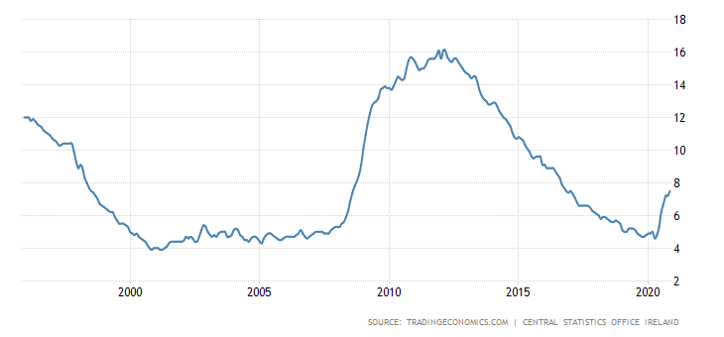
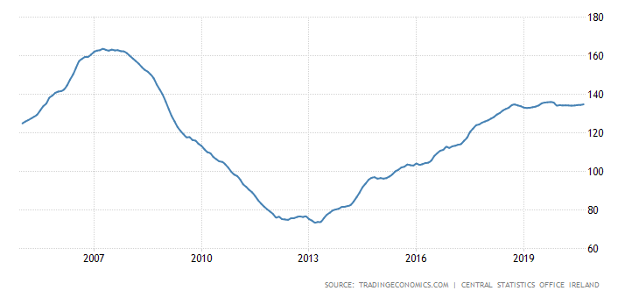
Here’s what happened the last time …
Unemployment rose quickly but steadily from 2008 to 2012 and then fell gradually and consistently. As Covid-19 struck in early 2020 the country was essentially at full employment.
House prices fell in an orderly (if speedy) fashion from 2008 to 2012, settled at a nadir for a year and slowly but steadily increased since.
This time unemployment and house prices are both going up. Our models are copying the graphs on the left.

Slide 41
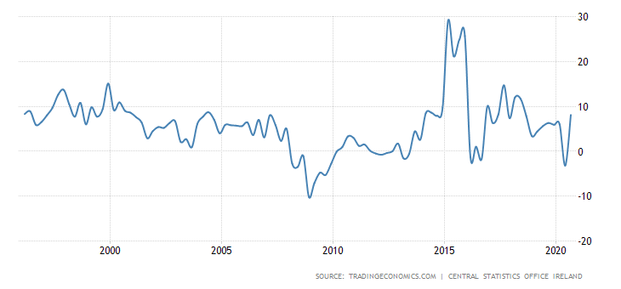
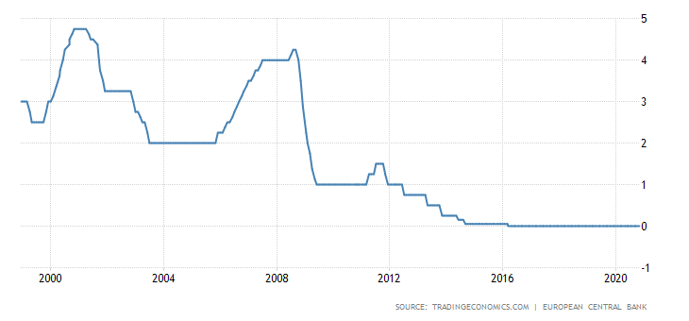
GDP and interest rates don’t help …
GDP is notoriously unreliable in an Irish context with the 2016 spike a leprechaun economics event that highlighted the gap between GDP and normal economic activity.
Interest rates, which usually feature in forecasting models, have been effectively held flat across the eurozone for a decade, thus weakening the accuracy of predictions.
ECB rate is now a constant and not a variable. GDP is sector dependent.

Slide 42
CSO unemployment is meaningless …
The COVID-19 adjusted unemployment rate for November 2020 was 21% for all persons including those on Pandemic Unemployment Payments.
The unemployment rate was 47.3% for persons aged 15 - 24 years and 17.4% for persons aged 25 - 74 years. At least 7.4% of PUP recipients have self-certified themselves as being registered as full-time students
The seasonally adjusted Monthly Unemployment Rate for November 2020 using standard methodology shows an unemployment rate of 7.5% for all persons, up from 7.2% in October 2020.
This unemployment rate was 20.2% for persons aged 15 - 24 years and 5.7% for persons aged 25 - 74 years
How many people under 24 have substantial borrowings in Ireland?
Which of these measures is feeding your models. It’s probably the PUP adjusted one, but your models have never heard of PUP.

Slide 43
Dept. of Finance in September …
Department of Finance’s Budget 2021 forecasts show that both COVID-19 and a disorderly end to the Brexit ‘transition period’ will have a significant impact
Modified domestic demand – proxy for domestic economy to fall by 6.5% this year
GDP is projected to fall by 2.5% in 2020 and to grow by only 1.4% in 2021
Impact of COVID-19 on GDP is less than previously expected, mainly due to the resilience of Multi-National Company exports - the hit to the domestic economy has been severe
Employment set to fall by 13.8% this year this with an annual average unemployment rate of just under 16% this year and 10.7% in 2021
Economic forecasts have been endorsed by the Irish Fiscal Advisory Council
This outlook is much better than May when H1 ECL was being estimated.

Slide 44
European Commission 5th November …
Ireland’s economy is projected to contract by 2.25% in 2020, before growing by 3% in 2021 (recovering 2019 levels) and 2.50% in 2022. Modified domestic demand, which better reflects the underlying domestic economy, is expected to fall by 6.50% in 2020 and grow by 7.25% in 2021 and 4.25% in 2022.
Employment has been shielded by state income support schemes. The economic contraction and the substantive fiscal stimulus are expected to significantly widen the budget deficit. Risks to the outlook remain exceptionally high, the European Commission warns.
The report projects that the euro area economy will contract by 7.8% in 2020 before growing 4.2% in 2021 and 3% in 2022. The forecast projects that the EU economy will contract by 7.4% in 2020 before recovering with growth of 4.1% in 2021 and 3% in 2022.
Dear CEO letter suggests base case alignment with the above!
This outlook is positively glowing, with a full economic recovery to January 2020 levels by end of 2021. It didn’t look like this in June.

Slide 45
Yet McNamara’s Fallacy abound today …
https://hbr.org/2010/12/robert-s-mcnamara-and-the-evolution-of-modern-management
The McNamara fallacy, named for Robert McNamara, the US Secretary of Defence from 1961 to 1968, involves making decisions based solely on quantitative observations (or metrics) and ignoring all others. The reason given is often that these other observations cannot be proven.
The first step is to measure whatever can be easily measured. This is OK as far as it goes.
The second step is to disregard that which can't be easily measured or to give it an arbitrary quantitative value. This is artificial and misleading.
The third step is to presume that what can't be measured easily really isn't important. This is blindness.
The fourth step is to say that what can't be easily measured really doesn't exist. This is suicide.
Daniel Yankelovich, Corporate Priorities: A continuing study of the new demands on business 1972
Look at how we measure Covid-19 today – classic McNamara
Road safety discussion are just another example of this fallacy
My own view is that what gets measured gets manipulated!
Almost exclusive focus on Covid-19 payment break population completely ignores second order effects but it’s a simple metric that people can relate to. It’s not telling the whole story.

Slide 46
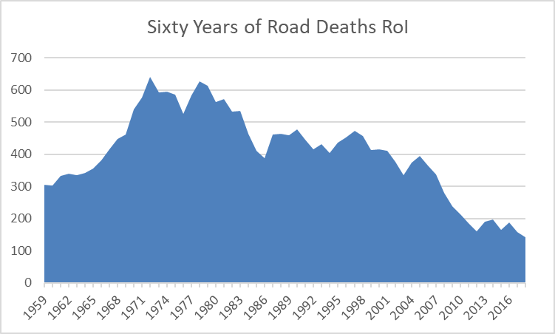
Humans extrapolate small samples …
Liz O’Donnell, Chairperson of the RSA, stated that “after recording the safest year on our roads in 2018, it is deeply saddening that not only have we lost 148 lives on the road in 2019, but that it represents an increase in road deaths”.
“Deeper collaboration between all agencies responsible for road safety is already taking place to ensure everything that can be done is being done, not only to reverse the increase in deaths this year, but to achieve the strategy target (124). “And it is a target that is very achievable, put simply it means saving two more lives a month, every month,”

Slide 47
Dear CEO letter is distracting (but noisy) …
https://www.bankingsupervision.europa.eu/press/letterstobanks/shared/pdf/2020/ssm.2020_letter_credit_risk_identification_measurement~734f2a0b84.en.pdf?c839e6212e8a9bf18dc0d26ab0b1cd7f
Mitigate excessive pro-cyclicality
Differentiate viable from non-viable debtors
Ensure concessions are correctly classified
Regularly assess borrower’s unlikeliness to pay
Identify and record any significant increase in credit risk early
Correctly estimate provisions using realistic parameters and appropriate assumptions aligned to ECB forecasts
Incorporate reliable macroeconomic forecasts
Exercise adequate oversight
Forecast the most likely impact of the crisis
Controversial as it may seem, six of the above should be happening already and the other three are impossible to promise to deliver.

Slide 48
Models should not carry this burden …
https://voxeu.org/content/mcnamara-fallacy-financial-policymaking
Have the financial policymakers today fallen for the McNamara fallacy?
In many aspects yes. They regulate by models, focusing on perceived risk and not actual risk.
Inevitably in policymaking, subjectivity is often seen as bad and objectivity good. If one is objective, one must have something objective to measure and control. And that requires numbers and statistical models.
Bank capital is worth discussing
There are of course a myriad of ways one can determine bank capital, such as the Basel risk-weighted assets and the leverage ratio, to name just two. Each of these have a lot of problems, not the least because of their dependence on measurements.
A much simpler, and quite possibly better way, to set capital would be for the authorities to predetermine the amount of capital a bank has to hold, using their subjective judgments. But of course, that can never happen. We need scientific objectivity and are stuck with the McNamara’s fallacy.
There is simply no way that mathematical models should play the role they do – and I understand and enjoy them! But it’s not right.

Slide 49
In fairness to the IFRS 9 …
It’s only in existence for three years: It takes many years for modelling methods to settle
It’s madness to expect humans to attach weights to scenarios: Humans are just not that clever and reality is a bit random
Back-testing is effectively impossible for IFRS 9: You’d have to re-calculate in the future what your model would have predicted in the past.
You couldn’t have picked a worse design in the context of Covid-19: Look what happened to Irish banks at H1. The 2008 – 2012 recession is limited in relevance and insight.
You couldn’t have picked a worse design in the context of Brexit: See comments above.
Nobody realised that the Chief economist would become the most important person in the bank in times of stress: This is now true!
The irony of course is that the accountants, lawyers and regulators that devised IFRS 9 never once considered a global pandemic, nor UK leaving the EU. The future is unpredictable – get used to it.

Slide 50
And what’s the general model advice ...
Models are struggling:
You’ll learn more from relative scenario outputs than modelled ECL
Compare the outcome from worst scenario with best for each portfolio
Ask lots of questions about portfolios with large ECL range
Models simplify reality:
Ask yourself do they capture all the big phenomena
Don’t treat models as if they are complicated but you can step through logically
There are two types of “overlays”:
Post model adjustments for known gaps between models and reality – not a model weakness
Management adjustments at end of ECL process – not a model weakness
Ask Committee presenters about both and to articulate rationale individually
To reinforce, understand what comes from models, what comes from top-ups or deductions where models are not capturing reality in a known way, and what comes from straight management judgment at the end of the process. Managers are paid to make judgments!

Slide 51
Some personal thoughts …
The world looks more positive than twelve months ago: Don’t be afraid to challenge over-provisioning
You can change your view again in H1 2021: Brexit will be real as will the efficacy of vaccines and roll-out plans
For mortgages in Ireland, politics is more important than models: Watch for any political narrative that condones Covid-19 defaults. The tendency for house prices to rise, allied to long repossession window, also confuses models.
You’ve got lots of capital: Remember capital protects against unexpected loss. Your provisions / ECL are not meant to.
Money generally cannot be created nor destroyed: Increased provisions just means less capital absent dividends (which Irish banks aren’t really contemplating at present)
Nothing is free in life: Extra conservatism is paid for by the customer in pricing!
And as benchmarks:
Ask how IFRS 9 worst scenario aligns with ICAAP scenario
Ask how IFRS 9 base scenario aligns with your normal business plan
My own view is that having extra money put aside doesn’t always make you safer – it should be considered along with culture, vision, decision making, processes, controls, a viable business strategy and many other factors.

Slide 52
Questions for specific portfolios …
Large Corporates:
Ask about individual names
CRE, Hospitality, Leisure are obvious hotspots
There will also be winners!
Small Businesses
Who has survived via government supports
What businesses are truly viable in the future
What businesses will owners give up on – they are entrepreneurs after all, and many have not sat around doing nothing
They may have a new business idea now and have moved on!

Slide 53
And for specific portfolios …
Mortgages
Everyone has an opinion on mortgages – ignore all of them (including mine)!
Discussions on payment break statistics will dominate
Ask how many customers have failed to return to at least servicing interest post payment break two
Be skeptical of any concrete conclusions around cure rates, loss rates, etc. based on historical data or payment break data. It’s all irrelevant but people do like to talk about what they understand as it makes them feel better.
Watch the political landscape!

